Slide 1
课程名称：通信原理 宋铁成（songtc@seu.edu.cn）
“通信”的理解
通信网：1、交换（Switch）
2、传输（Transmission）
3、接入（Access）
向下一代通信网络演进
本课程的定位：信息传输基础
本课程的安排（重要性、教材、参考书、教学方法、课程建设、考试和答疑）

Slide 2
通信的定义
通信发展的最终目标：
PCN（Personal Communication Network）
BIP-ISDN（Broadband Intelligent Personal-Integrated Service Digital Network）
物联网（The Internet of Things）&云计算（Cloud Computing）
通信网的组成：交换、传输和接入

Slide 3
交换
电路交换&分组交换、ATM交换、全光交换、IP交换
传输
有线传输：双绞线、电缆
无线传输：不同频段（微波、卫星）
光纤传输：准同步数字系列
(PDH,Plesiochronous Digital Hierarchy)
同步数字系列
(SDH,Synchronous Digital Hierarchy)
++2012年8月19日，武汉邮电科学研究院单模光纤实现17.32Tb/s传输速率，相当于2.1亿对人在一根光纤上同时通话。

Slide 4
接入
连接本地交换机与用户终端设备之间的部分。
用户终端设备可以是语音、数据和视频等。
三网合一：电话网、计算机网和有线电视网。
有线接入：双绞线接入、光纤接入(FTTB&FTTH &FTTR)、
混合光纤同轴电缆接入(HFC)
无线接入：固定接入(WLL,Wireless Local Loop)
移动接入(无绳电话系统、专用集群系统、
公用蜂窝系统1G/2G/3G/4G/5G)

Slide 5
第一代（模拟）和第二代（GSM和IS-95（中国电信））
第三代移动通信系统（3G，IMT2000）要求：
1.统一频段，统一技术标准，提供全球无缝覆盖和全球漫游的移动通信业务；
2.提供多媒体通信业务，包括语音、数据、可视图文、活动图象和压缩图象等业务；
3.传输速率最高达2Mb/s，其中：静止环境为2Mb/s，慢速移动环境为384Kb/s，快速移动环境为144Kb/s，卫星移动通信为9.6Kb/s；
4.高频谱效率，高服务质量和高保密性能；
5.便于由第二代蜂窝移动通信系统过渡和演进；
6.要求移动终端设备的价格较低廉。
W-CDMA(日欧方式)、cdma2000(北美方式) TD-SCDMA(中国和欧洲) WiMAX（韩国）
2000年5月 2000年10月 2007年10月

Slide 6
2G向3G的演进
GSM标准：
GSM(9.6kbit/s)→HSCSD(14.4~64kbit/s) →GPRS(171.2kbit/s) →EDGE(384kbit/s)
→W-CDMA(2Mbit/s) →HSDPA(10.8Mbit/s)
CDMA标准：
IS-95A(14.4kbit/s) →cdma2000 1x(144kbit/s) →cdma2000 1xEV(2Mbit/s)
TD_SCDMA何去何从？(频谱利用率高，成本低，我国政府强有力支持！)
WiMAX标准：意在4G？

Slide 7
3G进程
（奥运承诺？扩大内需？）2009年1月7日，工业和信息化部举行小型牌照发放仪式，确认国内3G牌照发放给三家运营商：中国移动（TD-SCDMA），中国电信（CDMA2000），中国联通（W-CDMA）。
中国电信（1920-1935MHz和2110-2125MHz），中国联通（1940-1955MHz和2130-2145MHz），中国移动（1880-1900MHz和2010-2025MHz）。
2009年1月22日，工业和信息化部、国家发展改革委、财政部、国资委、科技部等部门制定了一系列支持TD-SCDMA发展的财政支持、项目支持、网络建设、产品研发、业务应用和产业发展等六大扶持政策。
正在进行规模建设……有资料显示，中国移动3G网络的利用率目前还不到15%。

Slide 8
B3G或4G
2005年10月，ITU将B3G或4G技术正式命名为“IMT-Advanced”，该系统是包括蜂窝系统、无线城域网、无线局域网、无线个域网和广播接入等各种接入系统无缝覆盖的全IP通信系统。
4G技术将不局限于电讯行业，也将广泛应用于汽车通信业、民航业、广播电视业、国防工业、政府信息化系统、教育系统、医疗系统和金融系统等。

Slide 9
计划时间表：
目前处于预研阶段（关键技术研究）；
2007年，完成频谱分配；
2010年，完成主要标准；
2012年，开始商用；
2015年，投入大规模商用。

Slide 10
Beyond 3G或4G性能要求：
Beyond 3G或4G性能要求：
①用户速率在准静止（低速移动和固定）情况下达20Mbit/s，在高速移动情况下达2Mbit/s；
(4G的目标静态传输最高为1Gbit/s,高速移动为100Mbit/s。)
②容量要达到第三代系统的5-10倍，传输质量相当于甚至优于第三代系统；
③条件相同时小区覆盖范围等于或大于第三代系统；
④具有不同速率间的自动切换能力，以保证通信质量；
⑤网络的每比特成本要比第三代低。

Slide 11
关键技术
智能天线（Smart Antenna）；
软件无线电（Soft Radio）；
高速下行分组交换数据接入（HSDPA）；
自适应调制和编码（AMC）；
混合ARQ协议（H-ARQ）；
正交频分复用（OFDM）；
多入多出（MIMO）天线。

Slide 13
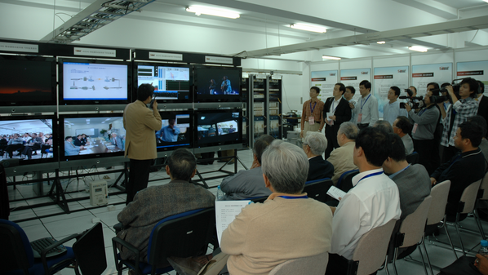
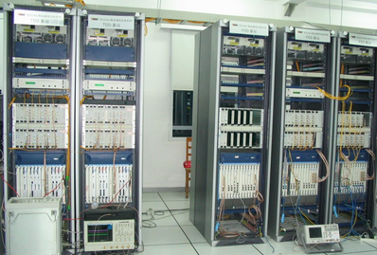
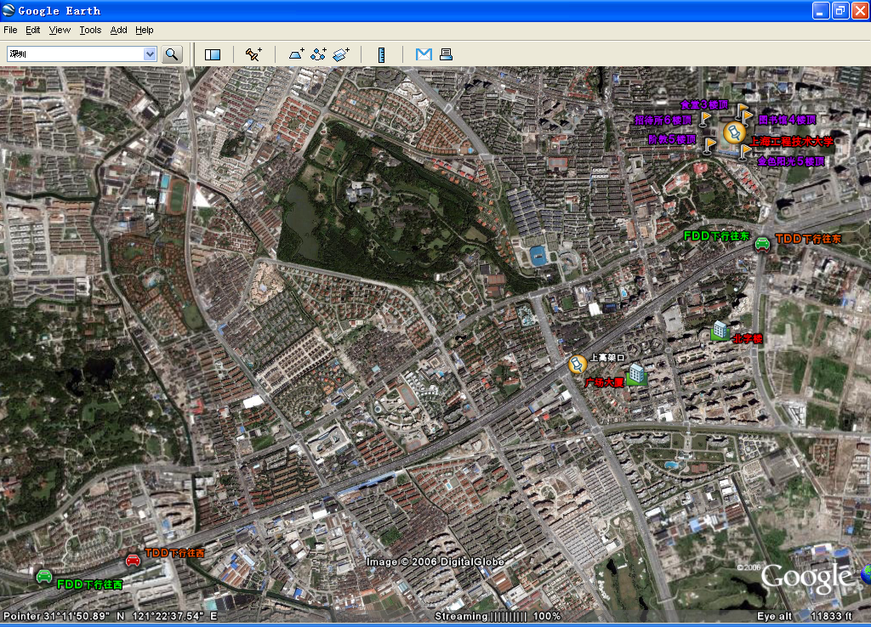
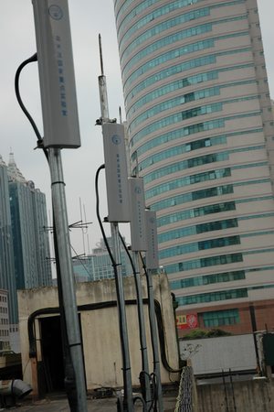
后三代（B3G）移动通信试验网
科技部B3G试验网验收现场
B3G基站
B3G外场
B3G天线阵列

Slide 14
2009年10月，我国向ITU提交了4G （TD-LTE-Advanced）的提案。
2010年10月21日，ITU在日内瓦总部发表媒体公报称，ITU无线电通信部门已完成对六种候选的全球4G移动无线宽带技术的评估；对这些建议进行协调后形成的两种技术也被定性为真正的4G 技术。
2010年10月22日，ITU确定LTE-A（包含TD-LTE-Advanced）和802.16m为4G标准。皆大欢喜？？？？
6个技术提案分别为(按提交文稿号顺序)：北美标准化组织IEEE(802.16m)、日本(两项分别基于LTE-A和802.16m)、3GPP(LTE-A)、韩国(基于802.16m)和中国(TD-LTE-Advanced)。

Slide 15
2012年9月11日，工信部部长苗圩确认：“工信部已决定将于一年左右的时间发放TD-LTE牌照”。2012年底，TD-LTE网络试验城市达14个，基站超过2万个。2013年底，100个试验城市，TD-LTE基站超过20万。
2013年2月，在巴塞罗那世界移动通信大会上，中国移动董事长奚国华发布了中国移动TD-LTE“双百”计划——2013年中国移动4G网络覆盖将超过100个城市(地市级以上)，4G终端采购将超过100万部，网络建成后将成为目前全球最大的4G网络。
2013年5月，中国移动计划采购数据类TD-LTE终端16万部，其中，MIFI约3万部，CPE约10万部，TD-LTE手机约1万部。
TD-LTE手机目前主要是受制于芯片，目前能够提供5模12频的芯片由高通等国外厂商，也有大唐旗下的联芯、华为海思等国内厂商。

Slide 16
2013年7月12日，国务院常务会议首次表态要求在今年年内发放4G牌照，工信部计划于今年年底前向三大运营商发放4G牌照。
2013年07月25日，工信部表示：4G牌照年内发放，目前尚无运营商申请。
中国4G牌照发放日趋明朗：中国移动肯定选择TDD，中国联通为FDD，中国电信存在变数：不是TDD就是被迫选择TDD/FDD双网双模。

Slide 17
中国电信已将4G网络试点从原来的4个省扩大至31个省，并于近期在南京首先开通4G试验网络。中国电信将采用FDD LTE/TD-LTE融合组网的方式组建4G网络，大范围、广覆盖的4G网络将使用FDD制式，而市区内人口稠密的高话务量的地区将使用TDD制式。
中国电信4G终端主要是手机、数据终端和卡三类产品。在手机上，推出FDD模式，部署CDMA+WCDMA+GSM+FDD LTE四模9频产品；数据终端为TDD+WIFI及TDD+FDD+WIFI组合，推出数据卡、MIFI和CPE产品；在卡方面，新卡将采用LTE+NFC。
中国联通计划每年投资100亿元建设3.1万个4G基站，未来还将逐渐加大投入。从WCDMA平滑推进到 FDD LTE网络。
据预测，到2015年，全球TD-LTE产业规模将达到1510亿美元，TD-LTE用户将达到9000万户。

Slide 18
5G消息
2010年10月，国际电联(ITU)启动了5G(IMT2020)预研工作。
欧盟METIS 5G项目总体负责人、爱立信大师级研究员Afif Osseiran也表示：“5G现在还在早期研究阶段，处于比较开放的状态，也许两年之后能够形成一个相对清晰的观点。”
5G标准、关键技术、频谱问题都未形成共识。
华为认为，与4G相比，可以引入新的调制、编码、协议栈、架构等设计，满足用户对无线业务的需求。
技术专家认为，网络编码、认知无线电、大规模MIMO、动态覆盖等都可以引入5G，以在提升速度的同时，进一步改善用户体验。
太多的未知数……
++++10Gbps?

Slide 19
2013年2月19日，由工信部、国家发改委和科技部三部委联合组织在北京召开了IMT-2020（5G）推进组成立大会，以联合产业界对5G需求、频率、技术与标准等进行研究为宗旨。
2013年4月19日，IMT-2020（5G）推进组第一次会议在北京召开，标志着我国移动通信第五代技术研究的开始。
2013年5月28日，“IMT-2020(5G)愿景展望”峰会在北京召开。与会代表认为，随着智能终端的普及以及互联网业务的飞速发展，到2020年，移动数据业务流量将增长1000倍。
5G将引入更加先进的技术，通过更高的频谱效率，更多的频谱资源以及更密集的小区部署等来共同满足移动业务流量增长的需求。同时，绿色节能和网络智能化也将成为5G重要的发展方向，降低能耗、提升网络的自组织和自优化能力，实现无线移动通信的可持续发展。
2013年7月，国家863计划“第五代移动通信（5G）系统前期研究开发（一期）” 启动。

Slide 20
全力推动“南京通信技术国家实验室”暨“南京∙中国无线谷”筹建工作。
2012年2月14日，东南大学尤肖虎教授牵头申报的“通信宽带移动通信容量逼近传输技术及产业化应用”研究成果获国家技术发明一等奖（全国仅有的两项之一，江苏省国家技术发明一等奖零的突破）。

Slide 21
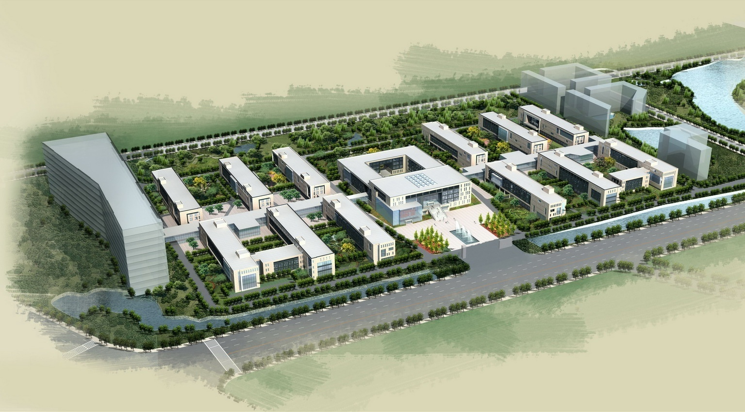
“南京∙中国无线谷”规划设计
学术交流、培训中心（二期）
拟筹建的通信技术工程中心（二期）
YYY研究部（三期）
通信协议与应用软件研究部
多媒体信息处理研究部
综合楼
集成电路研究部
公共检测中心
天线与射频研究部
XXX研究部（三期）
联合研究中心
核心网络与互连技术研究部
移动通信网络与系统研究部

Slide 22
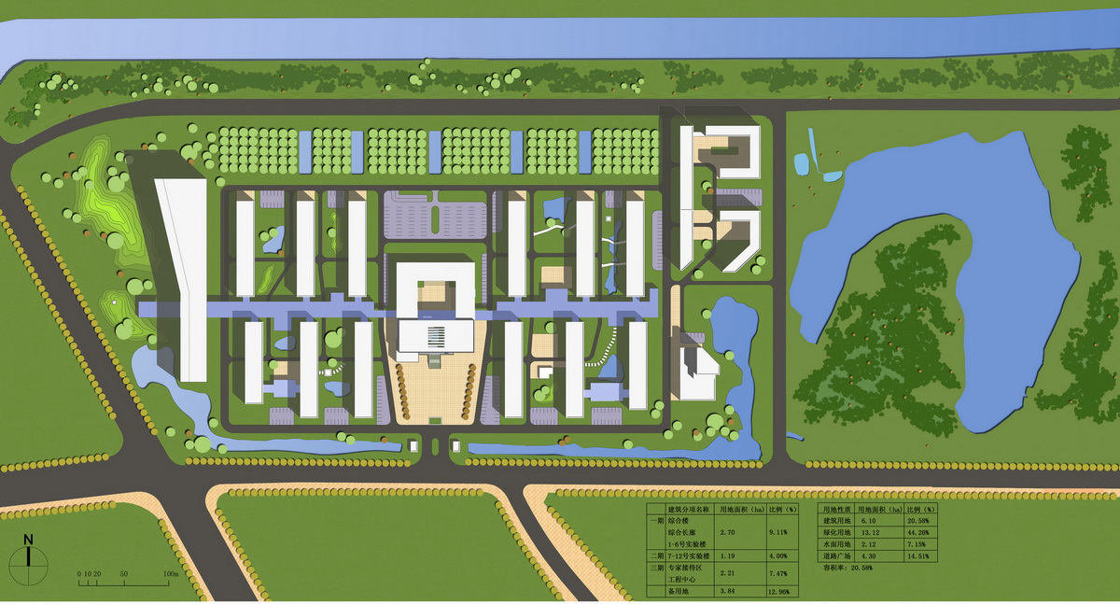
先进移动通信外场试验环境
外场测试控制、示范演示中心
无线接入单元
室外机房
外场试验环境主要组成部分： 1）办公/实验楼群构成典型的Manhattan街区无线信道模型； 2）园区道路，包括低速道路、高速道路；3）天线支架、供电结点、室外机房、通信电缆/光缆管道；4）外场试验控制/测试中心。

Slide 23
向下一代通信网络演进
向以软交换为核心的下一代交换网演进；
向以3G为代表的下一代移动通信网演进；
向以IPV6为基础的下一代互联网演进；
向多元化的宽带接入网演进；
向以光联网为基础的下一代传送网演进。

Slide 24
本课程的定位：信息传输基础
通信原理&数字通信技术
CH0: Background and Preview
CH1: Random Processes
CH2: Continuous-Wave Modulation
CH3: Pulse Modulation
CH4: Baseband Pulse Transmission
CH5: Singal-Space Analysis
CH6: Passband Data Transmission
================================
CH7: Spread-Spectrum Modulation
CH8: Multiuser Radio Communications
CH9: Fundamental Limits in Information Theory
CH10: Error-Control Coding
本课程的安排（重要性、教材、参考书、教学方法、课程建设、考试和答疑）

Slide 25
Communication Systems （Fourth Edition） Simon Haykin

Slide 26
CH0：Background and Preview
1. The Communication Process
2. Primary Communication Resources
3. Sources of Information
4. Communications Networks
5. Communication Channels
6. Modulation Process
7. Analog and Digital Types of communication
8. Shannon’s Information Capacity Theorem
9. A Digital Communications Problem
10. Historical Notes

Slide 27
1. The Communication Process
Irrespective of the form of communication process
being considered, there are three basic elements to
every communication system, namely, transmitter,
channel and receiver, as depicted in Figure 1.

Slide 28
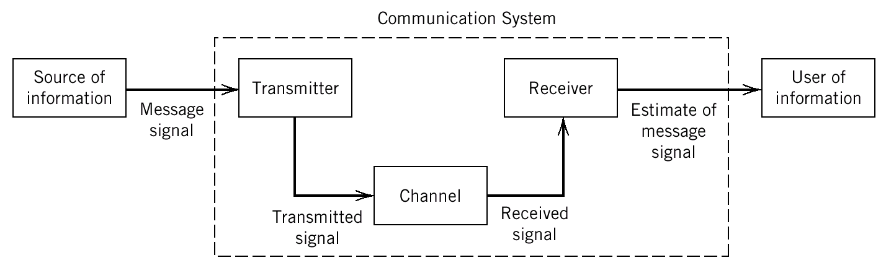
1. The Communication Process
Figure 1 Elements of a communication system

Slide 29
1. The Communication Process
The transmitter is located at one point in space, the receiver is located at some other point separate from the transmitter, and the channel is the physical medium that contacts them.
The purpose of the transmitter is to convert the message signal produced by the source of information into a form suitable for transmission over the channel. However, as the transmitted signal propagates along the channel, it is distorted due to channel imperfections.

Slide 30
1. The Communication Process
Moreover, noise and interfering signals (originating from other sources) are added to the channel output, with the result that the received signal is a corrupted version of the transmitted signal. The receiver has the task of operating on the received signal so as to reconstruct a recognizable form of the original message signal for a user.

Slide 31
1. The Communication Process
Two basic modes of communication:
Broadcasting
Point-to-point communication

Slide 32
1. The Communication Process
Broadcasting:
This involves the use of a single powerful transmitter and numerous receivers that relatively inexpensive to build. Here information-bearing signals flow only in one direction.

Slide 33
1. The Communication Process
Point-to-point communication:
This kind of communication process takes place over a link between a single transmitter and a receiver. In this case, there is usually a bidirectional flow of information-bearing signals, which requires the use of a transmitter and a receiver at each end of the link.

Slide 34
2. Primary Communication Resources
Transmitted power: The average power of the transmitted signal.
Channel bandwidth: The band of frequencies allocated for the transmission of the message signal.

Slide 35
3. Sources of Information
Four important sources of information:
Speech
Music
Pictures
Computer data

Slide 36
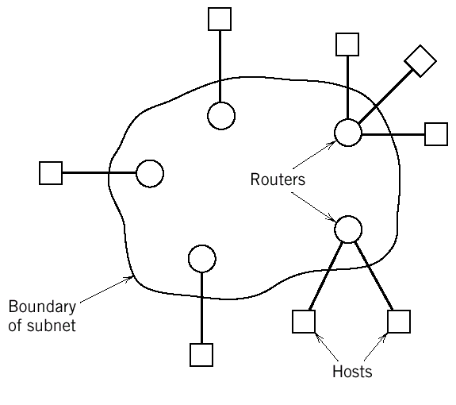
4. Communication Networks
Figure 4 Communication network

Slide 37
4. Communication Networks
Circuit switching is used to provide a delicates
communication path ,or circuit, between two hosts. The
telephone networks is an example of circuit switching.
Packet switching is based on “store and
forward.” The network may be viewed as a distributed pool
of network resources whose capacity is shared dynamically
by a community of competing hosts wishing to
communicate.

Slide 38
4. Communication Networks
In contract, in a circuit-switched network, resources are dedicated to a pair of hosts for the entire period they are in session.
Accordingly, packet switching is far better suited to a computer-communication environment in which bursts of data are exchanged between hosts on an occasional basis.

Slide 39
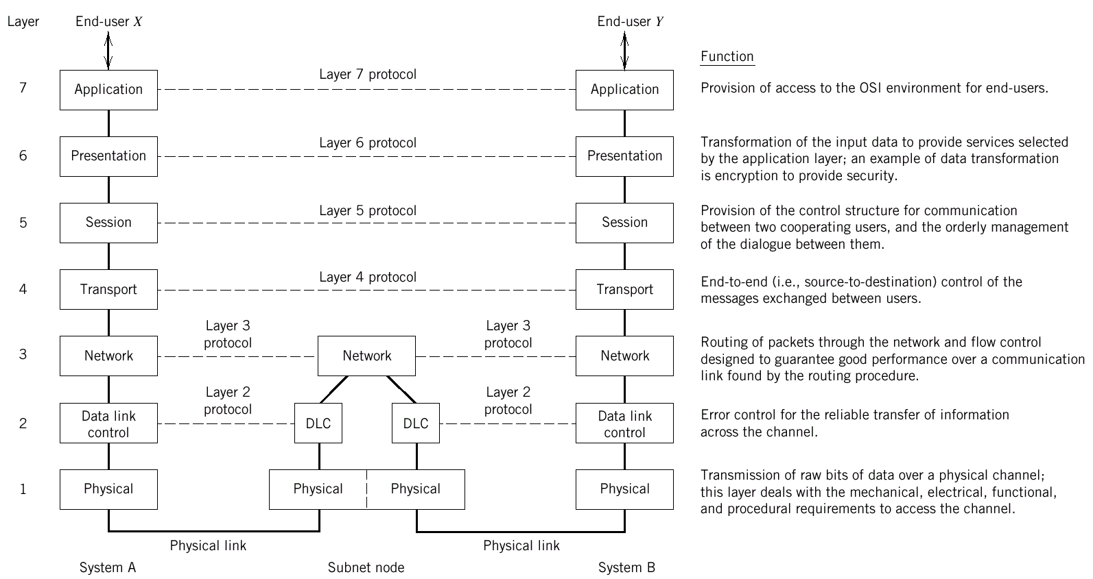
4. Communication Networks

Slide 40
4. Communication Networks
In the OSI reference model, the communications and
related-connection functions are organized as a series of
layers, or levels, with well-defined interfaces, and with each layer build on its predecessor.
The OSI model is composed of seven layers, as illustrated in that figure. Communication is achieved by having the peer processes in two different systems communicate via a protocol.
Main purpose of this book is the physical layer.

Slide 41
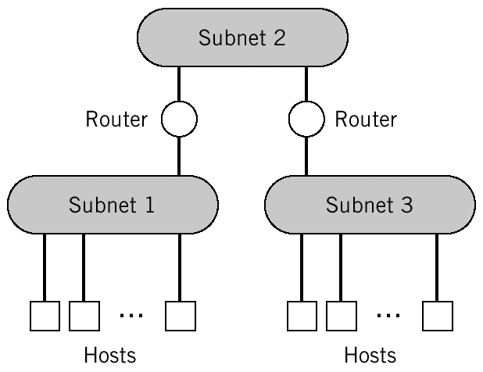
4. Communication Networks
Internet: Hosts, Subnets, Routers
Broadband Networks

Slide 42
4. Communication Networks
Internet:
The Internet architecture depicted in the Figure has three functional blocks: hosts, subnets, and routers. The hosts constitute nodes of the network, where data originate or where they are delivered. The routers constitute intermediate nodes that are used to cross subnet boundaries. Within a subnet, all the hosts belonging to that subnet exchange data directly.

Slide 43
4. Communication Networks
Broadband network :
ATM is a high-bandwidth, low-delay, packet-like technique
used for switching and multiplexing; it is independent of the
physical means of transport. The primary purpose of ATM is
to allocate network resources (i.e., bandwidth, buffers, and
processing horsepower) efficiently so as to guarantee the
expected quality of service for each connection.

Slide 44
5. Communication Channels
Two basic groups of communication channels
guided propagation
telephone channels
coaxial cables
optical fibers
free propagation
wireless broadcast channels
mobile radio channels
satellite channels

Slide 45
5. Communication Channels
Telephone network:
A typical telephone network uses circuit switching to
establish an end-to-end communication link on a temporary
basis. The telephone channel is a bandwidth-limited channel.
The telephone channel is built using twisted pairs for
signal transmission. Twisted pairs are usually made up into
cables, with each cable consisting of many pairs in close
proximity to each other. Twisted pairs are naturally
susceptible to electromagnetic interference (EMI), the effects
of which are mitigated through twisting the wires.

Slide 46
5. Communication Channels
Coaxial cable :
A coaxial cable consists of an inner conductor and outer conductor, separated by a dielectric insulating material.
Compared to a twisted-pair cable, a coaxial cable offers
greater degree of immunity to EMI. Moreover, because of
their much higher band-width, coaxial cables can support the
transmission of digital data at much higher bit rates than
twisted pairs.

Slide 47
5. Communication Channels
Optical fiber :
An optical fiber is a dielectric wave guide that transports
light from one place to another.In particular, they offer the
following unique characteristics:
Enormous potential bandwidth
Low transmission losses
Immunity to electromagnetic interference
Small size and weight
Ruggedness and flexibility

Slide 48
5. Communication Channels
Wireless broadcast channel :
Wireless broadcast channel supports the transmission of radio and television signals. The information-bearing signal, representing speech, music, or pictures, is modulated onto a carrier frequency that identifies the transmission station.
The transmission originates from an antenna that acts as the transition or match unit between the source of the modulated signal and electromagnetic waves in free space.

Slide 49
5. Communication Channels
The objective in designing the antenna is to excite the
waves in the required direction or directions, as efficiently
as possible.By virtue of the phenomenon of diffraction,
radio waves are bent around the earth’s surface.
Propagation beyond the line of sight is thereby made
possible, albeit with somewhat greater loss than is incurred
in free space.

Slide 50
5. Communication Channels
Mobile radio channel :
A mobile radio channel extends the capability of the public telecommunications network by introducing mobility into the network by virtue of its ability to broadcast.
In a mobile radio environment, we thus speak of a multipath phenomenon in that the various incoming radio waves reach their destination from different directions and with different time delays.
Consequently, the received signal strength signal varies with location in a very complicated fashion, and so a mobile radio.

Slide 51
5. Communication Channels
Satellite channel :
A satellite channel adds another invaluable dimension to the public telecommunications network by providing broad-area coverage in both a continental and an intercontinental sense.

Slide 52
5. Communication Channels
Summarize:
A communication channel is central to the operation of a communication system. Its properties determine both the information-carrying capacity of the system and the quality of service offered by the system. We may classify communication channels in different ways:
A channel may be linear or nonlinear;
A channel may be time invariant or time varying;
A channel may be bandwidth limited or power limited.
有效性&可靠性（模拟&数字通信系统）

Slide 53
6. Modulation Process
Modulation Process
continuous-wave modulation(CM): AM, FM, PM
pulse modulation(PM): PAM, PDM, PPM
Three commonly used methods of multiplexing:
SDM，FDM, TDM, CDM
Space/Frequency/Time/Code Division Multiplexing
WDM (Only for optical fiber)
SDMA，FDMA，TDMA，CDMA
Space/Frequency/Time/Code Division Multiple Access

Slide 54
6. Modulation Process
We may classify the modulation process into continuous-wave modulation and pulse modulation. In continuous-wave modulation, a sinusoidal wave is used as the carrier. In pulse modulation, on the other hand, the carrier consists of a periodic sequence of rectangular pulse. Pulse modulation can itself be of an analog or digital type.

Slide 55
6. Modulation Process
In introducing of modulation, we stressed its
importance as a process that ensures the transmission
of a message signal over a prescribed channel. There
is another important benefit, namely, multiplexing,
that results from the use of modulation.
Multiplexing is the process of combining several message signals for their simultaneous transmission over the same channel.

Slide 56
6. Modulation Process
Three commonly used method of multiplexing are as follows:
Frequency-division multiplexing (FDM)
Time-division multiplexing (TDM)
Code-division multiplexing (CDM)

Slide 57
6. Modulation Process
In FDM the message signal overlap with each other at the channel input: hence the system may suffer from crosstalk if the channel is nonlinear.
In TDM the message signals used the full passband of the channel, but on a timeshared basis.
In CDM the message signals are permitted to overlap in both time and frequency across the channel.

Slide 58
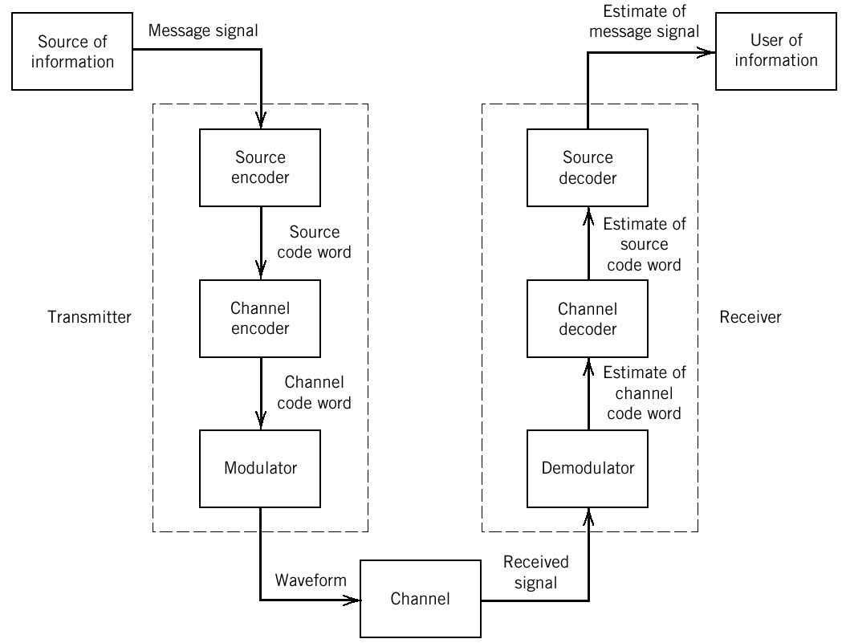
7. Analog and Digital Types of Communication

Slide 59
7. Analog and Digital Types of Communication
Consider first the case of a digital communication system
represented by the block diagram of Figure .The functional
blocks of the transmission and the receiver, starting from the far
end of the channel, are paired as follows:
Source encoder-decoder（有效性）
Channel encoder-decoder（可靠性）
Modulator-demodulator

Slide 60
7. Analog and Digital Types of Communication
The source encoder removes redundant information from the message signal and is responsible for the efficient use of the channel. The data stream is processed next by the channel encoder. Finally, the modulator represents each symbol of the channel code word by a corresponding analog symbol.
At the receiver, the channel output (received signal) is processed in reverse order to that the transmitter, thereby reconstructing a recognizable version of the original signal.

Slide 61
7. Analog and Digital Types of Communication
The reconstructed message signal is finally delivered to the
user of information at the destination.
In contrast, the design of an analog communication system
is simple in conceptual terms but difficult to build.
The detail of these are determined by the type of CW
modulation used .

Slide 62
8. Shannon’s Information Capacity Theory
C=B*log2(1+SNR) (b/s)
信息量定义？I = log2(1/p) bit
1. Bound
2. Trade-off（带宽趋向于无穷大呢？）
3. framework

Slide 63
8. Shannon’s Information Capacity Theory
The information capacity theorem states that ideally these
two parameters are related as:
C=B*log2(1+SNR) (b/s)
where C is the information capacity of the channel. The information capacity is defined as the maximum rate at which information can be transmitted across the channel without error; It is measured in bits per second (b/s).

Slide 64
8. Shannon’s Information Capacity Theory
For a prescribed channel bandwidth B and received SNR, the
information capacity theorem tells us a message signal can be
transmitted through the system without error when the channel
is noisy, provided that the actual signaling rate R in bits per
second.
Unfortunately, Shannon’s information capacity theorem does not tell us how to design the system.

Slide 65
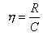
8. Shannon’s Information Capacity Theory
From a design point of view, the theorem is very valuable for
the following reasons:
1:The information capacity theorem provides a bound on
what rate of data transmission is theoretically attainable for
prescribed values of channel bandwidth B and received
SNR.
On this way, we may use the ratioη as a measure of
the efficiency of the digital communication system under
study. The closer η is to unity, the more efficient the
system is.

Slide 66
8. Shannon’s Information Capacity Theory
2:For a prescribed signaling rate R, we may reduce the required SNR by increasing the channel bandwidth B.
3:The shannon equation provides an idealized framework for comparing the noise performance of one modulation scheme against another.

Slide 67
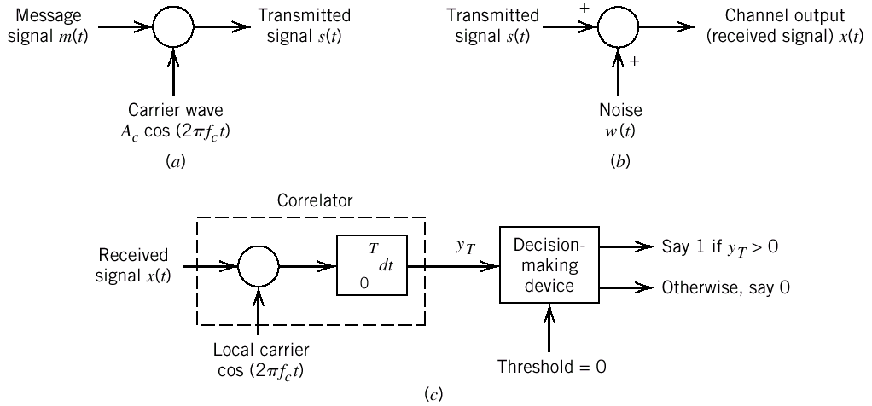
9. A Digital communication Problem
Figure 10 Elements of a digital communication system. (a) Block diagram of transmitter. (b) Block diagram of channel. (c) Block diagram of receiver.

Slide 68
9. A Digital communication Problem
Suppose we have a random binary signal, m(t), consisting
of symbols 1 and 0 that are equally likely. We employ a simple
modulation scheme as phase-shift keying.
Figure a shows a block diagram of the transmitter, the
output of which is defined by: , where
0≤t≤T. The carrier frequency is a multiple of 1/T.

Slide 69
9. A Digital communication Problem
The channel is assumed to be distortionless but noisy, as
depicted in Figure b.
The received signal is defined by:
Where is the additive channel noise.
The receiver consists of a correlator followed by a
decision-making device, as depicted in Figure c. The correlator
multiplies the received signal by a locally generated carrier
.

Slide 70
9. A Digital communication Problem
Then integrates the product over the symbol interval
, producing the output :
If the correlator output is greater than zero, the
receiver outputs symbol 1; otherwise, it outputs symbol 0.

Slide 71
9. A Digital communication Problem
There are some important practical issues that need attention:
Channel bandwidth is a highly valuable resource. How do we choose a modulation scheme that conserves bandwidth in a cost-effective manner?
How do we design the channel encoder in the transmitter and the channel decoder in the receiver so as to come very close to Shannon’s information capacity theorem in a physically realizable manner?
How do we synchronize the receiver to the transmitter with respect to both the carrier phase and symbol timing?

Slide 72
10. Historical Notes
1837，Telegraph----Samuel Morse
1864，Electromagnetic theory----James Clerk Maxwell
1875，Telephone----Alexander Graham Bell
1904，Vacuum-tube diode----John Ambrose Fleming
1918，Superheterodyne radio receiver----Edwin H. Armstrong
1928，All-electronic television----Philo T. Farnsworth
1937，PCM for speech----Alec Reeves
1943，Matched filter----D. O. North
1947，Geometric representation of signals----V. A. Kotel’nikov
1948，Information Theory----Claude Shannon
1948，Transistor----Bell Laboratories
1943-6，Electronic digital computer----University of Pennsylvania
1950-70，Computer Networks----ARPANET (1985—Internet, 1990----WWW)

